Slide 1
MIN-HASH
By,
MK Apoorva
Arpitha Raghunandan
Madhuparna Bhowmik
Sreeja

Slide 2
Important Terms
Minhashing
It is a technique for quickly estimating how similar two sets are.
Jaccard similarity
It is the indicator of the similarity between two sets.
J(A,B) = ( A ∩ B ) / ( A U B )

Slide 3
Important Terms
Shingles
Parsing the document by taking each possible string of three (or as many as preferred) consecutive words from the document
Example: “Parsing the document”, “the document by”, “document by taking” and so on.
Signatures
Each shingle is converted to an integer, which is used to generate a signature using the following hash function:
h(x) = ( ax + b ) % c

Slide 4
Reason for using Minhash
To calculate J(A,B) quickly ,without explicitly computing the intersection and union.
Example:
If we have a collection of 10,000 articles which contain, on average, 250 shingles each, computing the Jaccard similarities directly for all pairs will take a long time. Here, generating and comparing the MinHash signatures takes much less time.

Slide 5
Application of MinHash
We have used MinHash on:
Grouping of Text documents
Clustering of Images

Slide 6
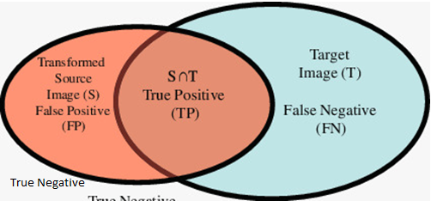
Text Documents
F1 Score = ( 2 * Precision * Recall ) / ( Precision + Recall )
Precision = ( True Positive ) / ( True Positive + False Positive )
Recall = ( True Positive ) / ( True Positive + False Negative )

Slide 7
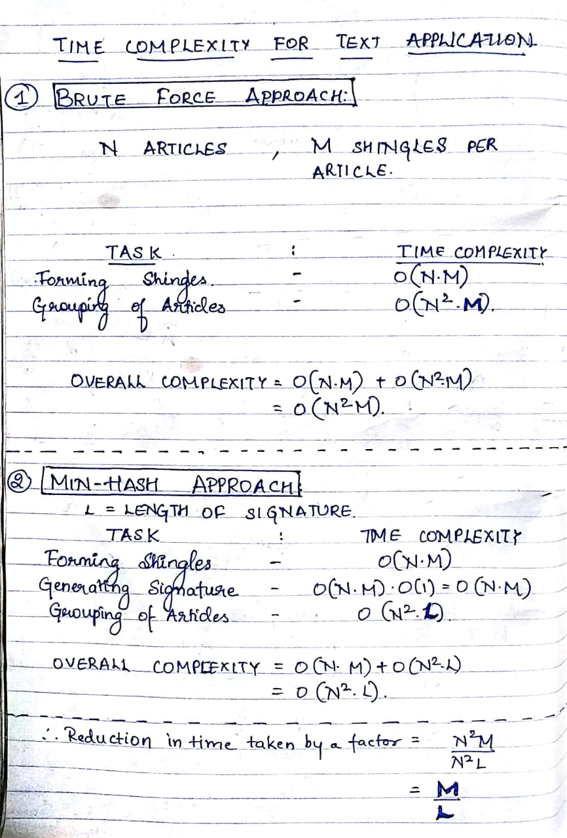
Time Complexity

Slide 8
Images

Slide 9
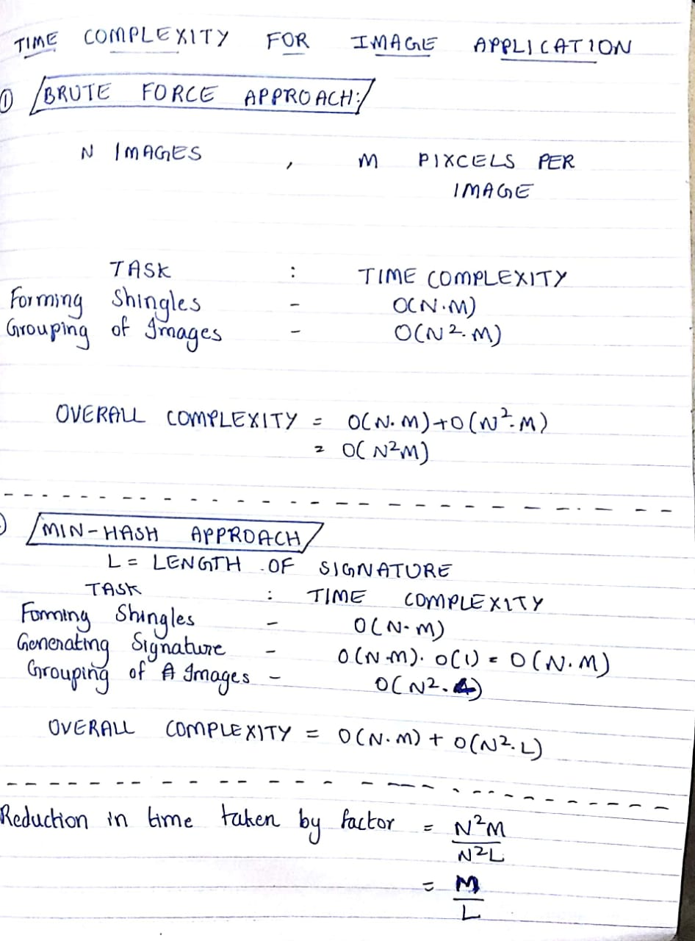
Time Complexity

Slide 10
Thank You.

